Slide 1
R-objects or Data structures
R consists of a number of data objects to perform various functions.
Application of R-Programming in Plant Pathology and Microbiology: Lecture 3 & Practical 3. Dr. Aqleem Abbas

Slide 2
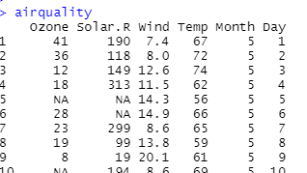
R-objects
Datatypes
Numeric; real or Decimal or a fractional part
Integers; non decimals, + and – integers (whole numbers or counting numbers) 6L , L tells R this is integer
Characters; A letter or a combination of letters enclosed by quotes is considered as a character data type by R.
It can be alphabets or name. "aqleem", “abc"
Logical: A variable that can have a value of True and False like a boolean is called a logical variable.
Complex:1+5i (complex numbers with real and imaginary parts)
Vectors
Lists
Matrices
Arrays
Data Frames
Factors
Attributes/Properties: Attributes are part of the object.
Air quality:
row.names and col.names
Datatypes or Values
Attributes

Slide 3
Vectors
One row or one column of data, so simplest type of data structure in R.
A vector is a sequence of data elements of the same basic type (numbers/logical).
For example. 1 to 100 fungi: F = 1:100
For example. Bacteria: B = seq(1,10,.5)
1. Numeric vector 2. Logic vector 3. Character vector
A vector can be created with a function c(), which will combine all the elements and return a one-dimensional array.
For example: c(2, 3, 5), this is a vector containing 3 numeric values 2,3 and 5.
#And here is a vector of logical values.
c(TRUE, FALSE, TRUE, FALSE, FALSE)
#If you want the numbers of members in a vector use length function. Length also function for lists.
length(c("aa", "bb", "cc", "dd", "ee"))
Class(x): it tells the type of data or the type of object.
Length: tells you the number of things in that object. It actually counts elements.
Vector length: no of objects
List/data frame length: no of things in a list. Length(air quality)

Slide 4
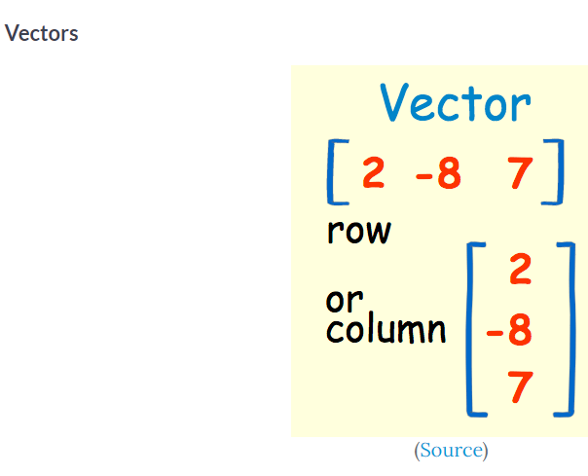

Slide 5
List
Unlike vectors, a list can contain elements of various data types and is often known as an ordered collection of values.
It can contain vectors, functions, matrices, and even another list inside it (nested-list; One dimentional).
list1 <- list(5,"b",TRUE)
list1
class(list1)
class(list1[[1]])

Slide 6
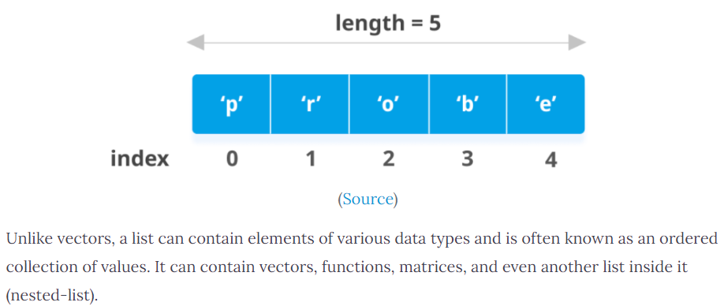

Slide 7
Matrix
Collection of elements of the same data type (numeric, character, or logical) arranged into a fixed number of rows and columns.
The general format is matrices are capable of holding two-dimensional information inside it.
They are not a separate type of object but simply an atomic vector with dimensions; the number of rows and columns.
As with atomic vectors, the elements of a matrix must be of the same data type.
Two dimensional homogenous data: rows and columns

Slide 8
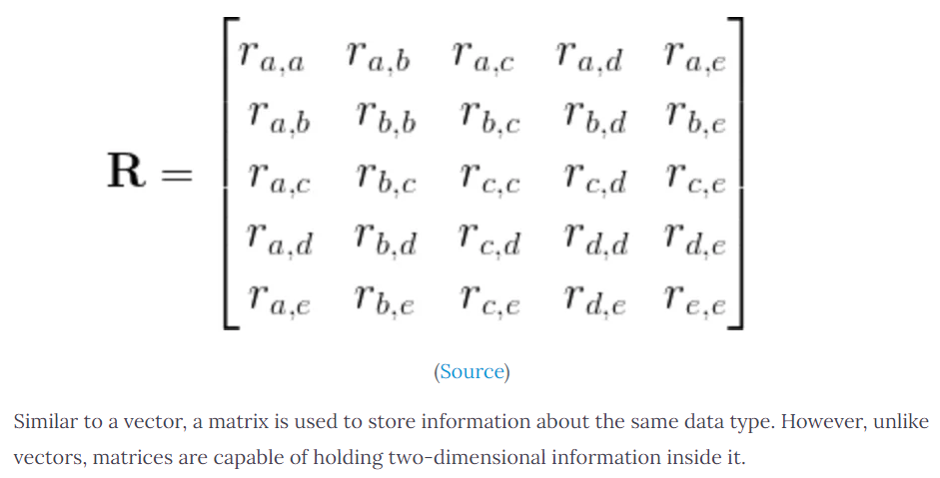

Slide 9
Factors
Factors: Machine learning models; qualitative relationship like colors, good and bad, course or movie ratings, etc. For example. Different colors in a rainbow.
For example
color
gender = c(rep(1,6), rep(2,6))
as.factor(gender)
Gender = as.factor(gender)
gender = as.factor(gender)
gender = c(rep("male",6), rep("female",6))
gender = as.factor(gender)

Slide 10
Arrays
Arrays are similar to matrices and can have one, two or more dimensions.
.A two-dimensional array is the same thing as a matrix.
For example − If we create an array of dimension (2, 3, 4) then it creates 4 rectangular matrices each with 2 rows and 3 columns. Arrays can store only data type.

Slide 11
Data Frames
A data frame is more general than a matrix, in that different columns can have different modes (numeric, character, factor, etc.).
A data frame is a very important data type and similar to the tabular data(Table, excel sheet) of other statistics.
A data frame is a special type of list where every element of the list has same length (i.e. data frame is a “rectangular” list).
rownames(), which can be useful for annotating data, like subject_id or sample_id.
Usually created by read.csv() and read.table(), i.e. when importing the data into R.
Can also create a new data frame with data.frame() function.

Slide 12
